Slide 1
Design Demonstration
Android APP Development

Slide 2
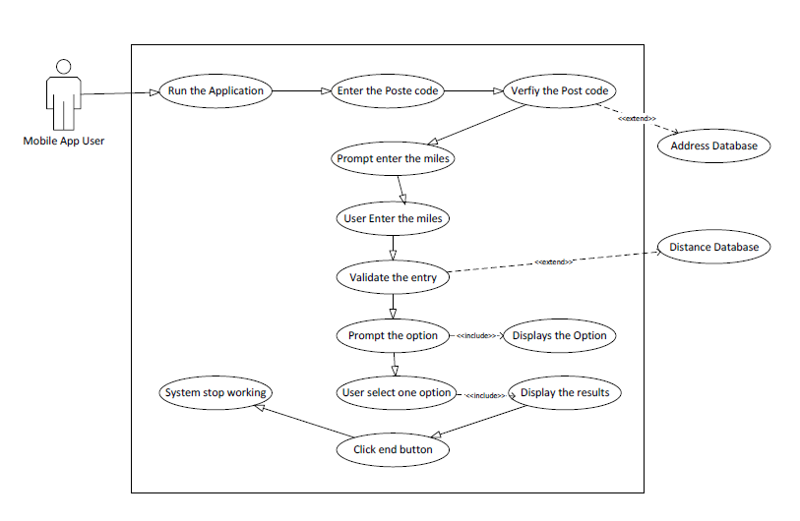
Search By Postcode Use case

Slide 3
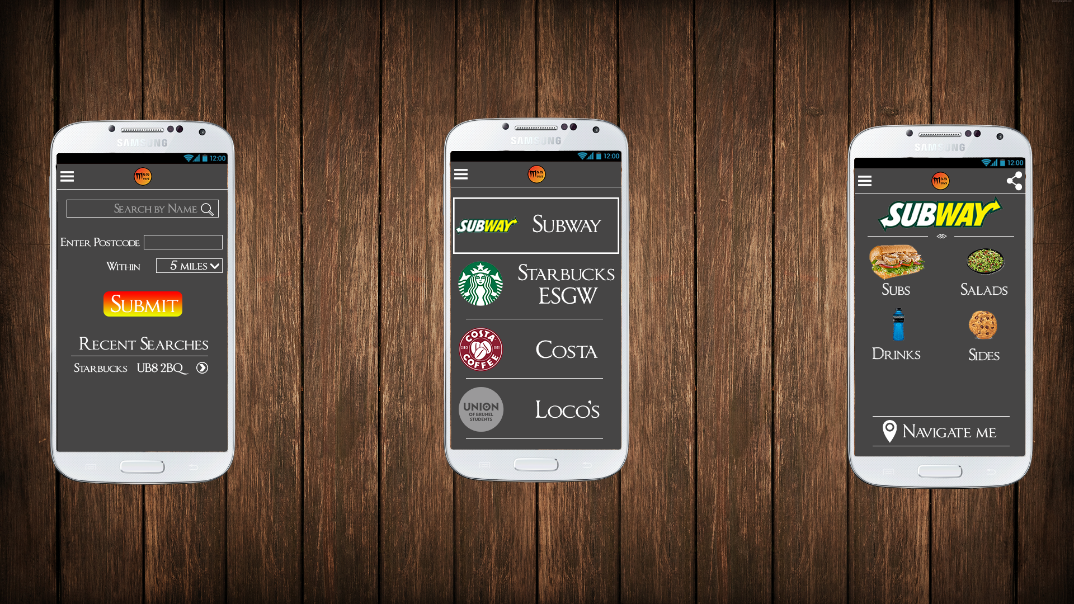
Search By Name/Postcode
Navigation (Menu System)
Company Logo
Search Box
Text field to accept user input
Dropdown list to choose an option
Button to submit the user input
Displays the recent search results
1
2
3
4
5
6
7

Slide 4
List of Stores
Navigation ( Menu System)
Store Logo
Store Name
1
2
3

Slide 5
Example Menus
Share button
Store Name
Sub Menu
Navigation to the store
1
2
3
4

